Slide 1

Easy F5/NGINX Integrating using OpenShift 4.11
Mark Dittmer
F5 Automation and Ecosystems

Slide 2
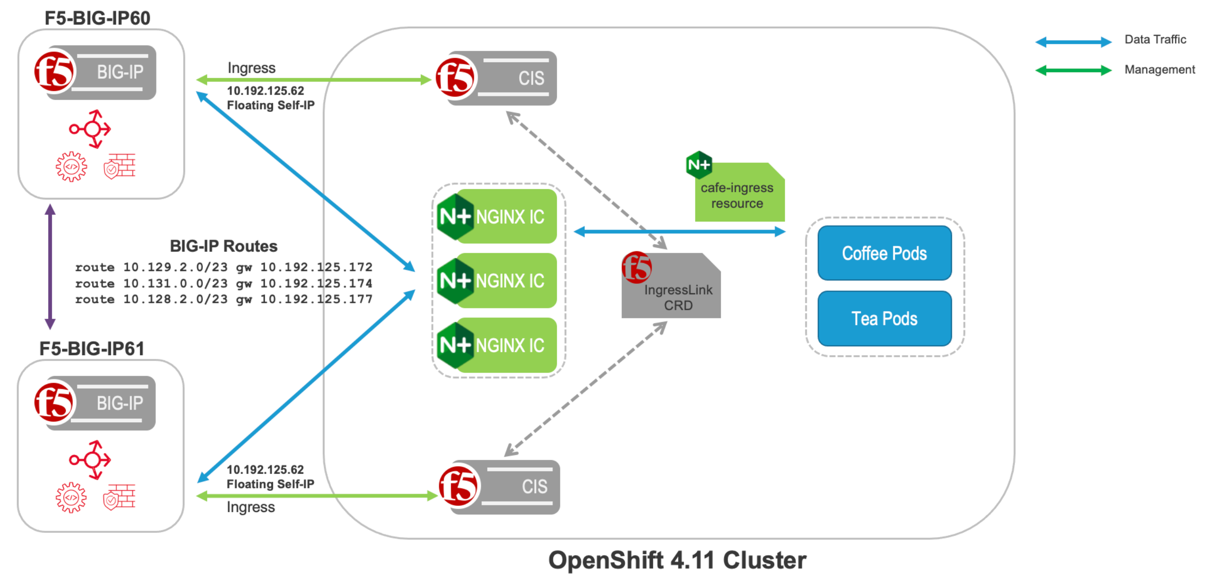
F5 BIG-IP and NGINX provides a solutions called IngressLink
F5 BIG-IP Container Ingress Services (CIS) and NGINX Ingress Controller deployed in OpenShift 4.11
Offering the best of F5 BIG-IP and NGINX and fostering better collaboration across NetOps and DevOps teams

